Slide 1
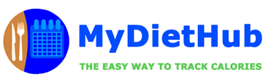
MET CS 673 - Software Engineering
Team 4
Iteration 3
Final Presentation

Slide 2
Team 4 - Members Overview
Team Leader: Ray Clark
Requirements Leader: Chen Zhao
Design & Implementation Leader: Daniel Graziano
QA Leader: But Wing Han Josephine
Configuration Leader: Huimin Diao
Security Leader: Zixia Zhou
All Team 4 members will be presenting today!

Slide 3
Iteration 3 Presentation - Contents
Application Overview & Development
Project Management
Requirements Analysis
System & Software Design
Implementation
Testing Plan & Results
Security
Deployment
Software Demonstration
Member Takeaways

Slide 4
Section I
Application Overview & Development
Presenter: Ray Clark

Slide 5
MyDietHub - Application Overview
Application Overview
Research: According to the National Health & Nutrition Examination Survey (2013–2014), approximately 2 in 3 adults in the U.S. are either overweight or obese.
App: MyDietHub is a full stack application built on Python-Flask framework that allows a user to compute the calories of a given food type and for an entire meal.
Purpose: The purpose of the application is to allow a user to track their caloric intake and thereby regulate their diet.
Users: Any person hoping to regulate their caloric intake and track their diet.
Notes:
As you can see, being overweight is a common problem for many Americans right now. The problem of being overweight can be linked to diet.
So the purpose of our application which named MyDietHub is to allow a user to track their caloric intake and thereby regulate their diet.
MyDietHub is a full stack application built on modern frameworks that allows a user to compute the calories of a given food type and for an entire meal.
And Any person hoping to regulate their caloric intake and track their diet.

Slide 6
Revision History
Iteration 1 - Key Outcomes: Completed the initial code development for three (3) distinct components:
Registration/Login Module, USDA API Module, CRUD Operations Module
Prepared unit tests to test key functionality
Iteration 2 - Key Outcome: Completed the integration of the three (3) modules into a working app:
Combined the Reg/Login, USDA API, & CRUD modules into one (1) integrated system - MVP
Refactored these primary modules to eliminate key code smells
Iteration 3 - Key Outcome: Completed input validation and testing:
Added additional input validation & exception handling
Created additional unit and system tests using Selenium

Slide 7
Section II
Project Management
Presenter: Ray Clark

Slide 8
Project Management
Overview
Management Style
Meetings
Training/Pair Programming
Use of PivotalTracker

Slide 9
Management Style
Overview
Approach - Attempted to adhere to Agile Scrum methodology & sprint planning
Attempted to complete working code at the end of each sprint/iteration:
Iteration 1 - completed working code for three (3) distinct modules
Iteration 2 - Integrated all 3 modules into a working system - MVP
Iteration 3 - Integrated advanced features, testing & exception handling
Given team time zones, no daily stand-up meeting, instead conducted 2 meetings/week
Combined upcoming sprint planning with iteration retrospective
Given time zones, encouraged individual education & pair programming

Slide 10
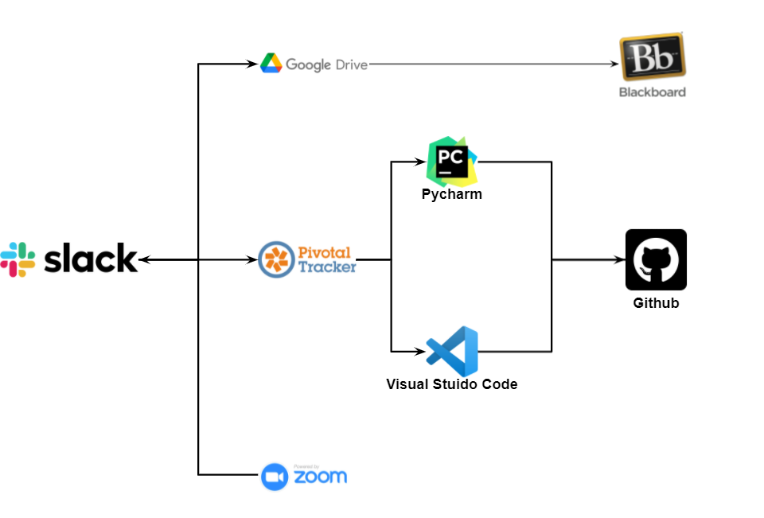
Meetings
Overview
Created a meeting agenda for each stand-up meeting
Given schedules and time zones, conducted 2 meetings per week - Wednesday & Monday @ 5;45 PM PT
Meeting agenda served as basis to update meeting minutes - minute taker assigned at each meeting
At meeting, combined upcoming sprint planning with retrospective
Supplement meetings on week of iteration delivery
Extensive use of Slack for task completion/group communication

Slide 11
Training/Pair Programming
Overview
Given time zones, encouraged individual education & training for technical competency
E.g., Flask tutorial, then CRUD module
Encouraged self-organizing, pair programming teams:
Both programmers actively engaging with the task throughout a paired session, otherwise no benefit can be expected
Both programmers expected to keep up a running commentary - “programming out loud”
Experience: In this case, time zones and schedules precluded effective pair programming
Individuals worked in isolation - Instead, Slack communication as code sections completed

Slide 12
Use of Pivotal Tracker
Overview
Meeting Agenda included new or revised requirements & tasks for new iteration
Pivotal Tracker updated following meeting:
Requirements Update
Task Update
Metric update
Story clean-up
Bug Review
Work assignment

Slide 13
Section III
Requirements Analysis
Presenter: Chen Zhao & Josephine But

Slide 14
Requirements Analysis
Functional Requirements
Essential Features:
User Registration
User Login
Create a meal
Retrieve the meal nutrition information
Update a meal
Delete a meal
Administrator Login
Administrator retrieve user record
Administrator update user record
Administrator delete user account
Optional Features:
Input of multiple food items
User can search the meal by meal type and meal date
Meal nutrition information can be calculated by the quantity of the food
Input calories suggestion based on user’s gender, age, weight and height
Be able to query DB based on varying criteria
Non-Functional Requirements
Application speed
Login page load time will not exceed 1 second
The total time the system takes to access the USDA database and return the data to the user will not exceed 5 seconds.
Reliability
The system will have a minimum 85% reliability for any given month meaning it will be up and operating at least 85% of the time.
Portability
The application will operate on Windows 10x and higher, macOS 11x and higher and iOS 14x and higher.

Slide 15
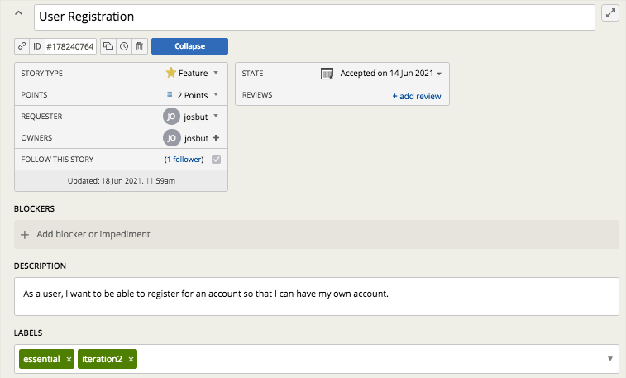
Pivotal Tracker - User Stories
Create user stories to represent software’s functional requirements and drive the whole development process

Slide 16
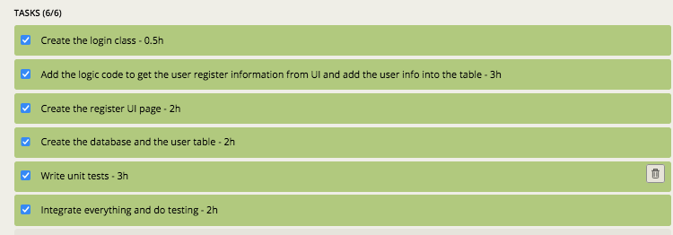
Requirement Tasks
Tasks in the user story can estimate the development time and keep track the progress of the development.

Slide 17
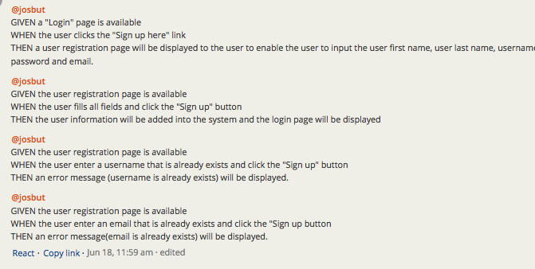
Acceptance Tests
Acceptance tests to confirm that the user story is implemented correctly.

Slide 18
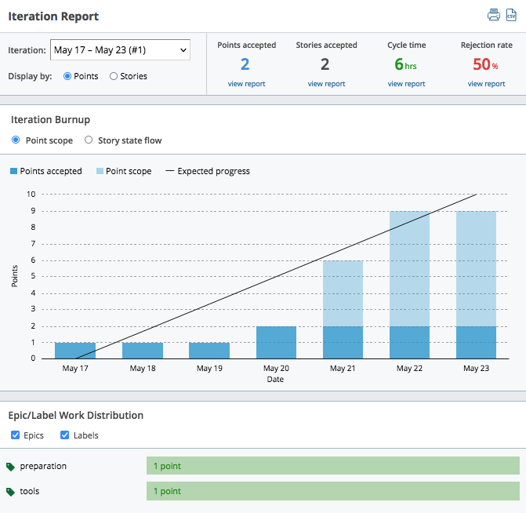
Results - At the beginning of the project

Slide 19
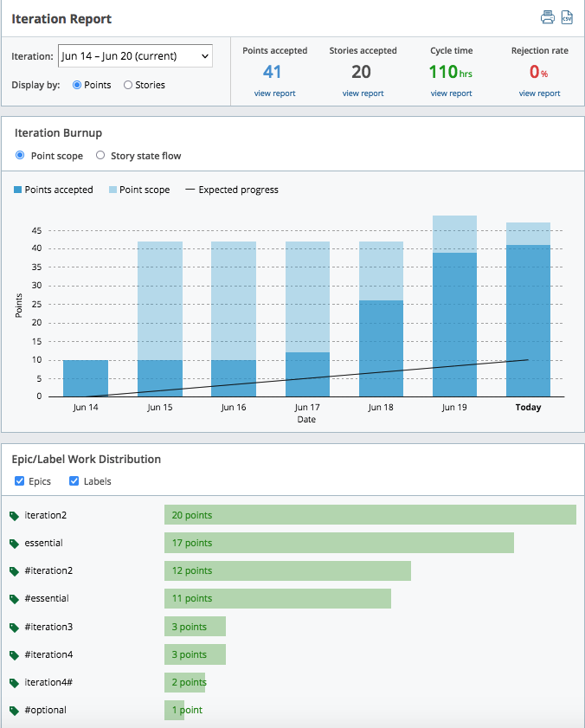
Results - At End of Project

Slide 20
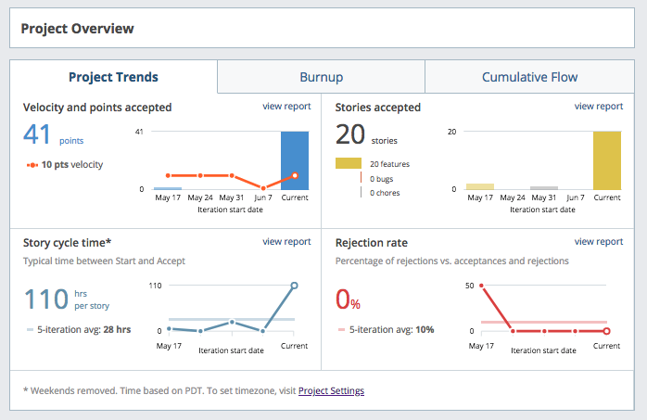
Project Overview Results

Slide 21
Section IV
System & Software Design
Presenter: Danny Graziano & Huimin Diao

Slide 22
Design - Overview
System Design - Layered Structure:
In a layered architecture, the system is divided into layers, with each layer providing a related set of services to upper layers
Layered architecture is a generic architecture that defines the relationships between components
MVC (model-view-controller) pattern is a special type of the layered architecture
When layers are distributed physically on nodes, the structure is referred to as a “Tiered Architecture”
MyDietHub: Layered, MVC Structure - App (controller/model) deployed on Heroku, view on client browser, is 2-nodes or tiers
Software Design:
MVC structure: Python-Flask Framework with all key functionalities in separate files
Model - Models.py contains database models/schema and objects for User, Admin & Meal
View - All view templates are based on Python-Flask/Jinja2 syntax and are contained in the Templates folder
Controller - App.py & routes.py contain control code for CRUD operations

Slide 23
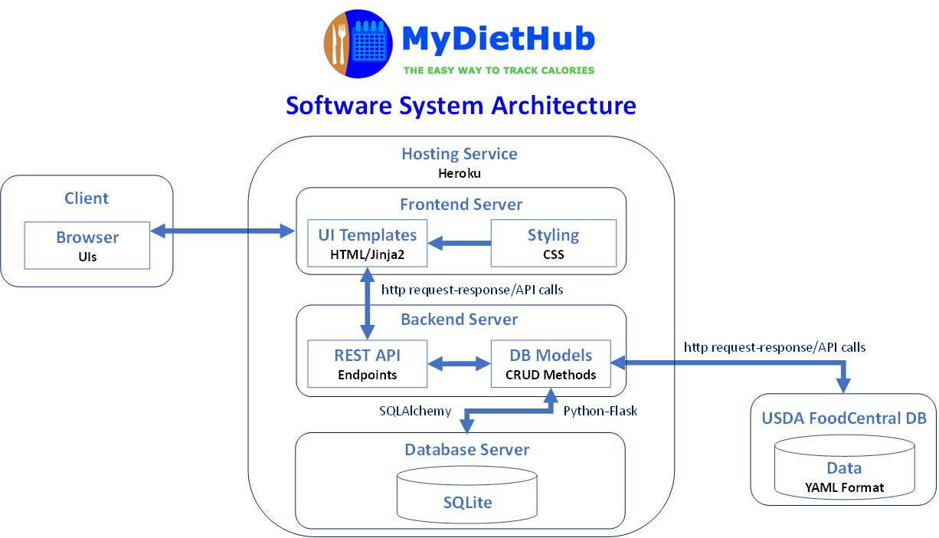
System Architecture - Layered Structure Diagram

Slide 24
Software Architecture - MVC Pattern
Overview
Model–view–controller (known as MVC) - Software design pattern commonly used to develop user interfaces that divides related program logic into three interconnected elements
MVC architecture - Model is responsible for application-domain data, View displays the model and is templates to render HTML pages, Controller (logic) handles requests & responses
MyDietHub - MVC
Data Layer (Model) is implemented using a SQLite relational database
View Layer uses interfaces developed using HTML5/CSS3 and Jinja2
Controller Layer is built as a REST API using the Python-Flask framework that provides API endpoints to perform various CRUD (create-read-update-delete) operations
The diagram on the following page illustrates the MVC software architecture

Slide 25
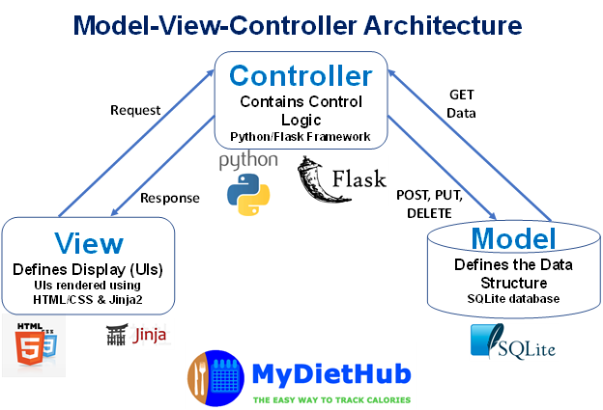
Software Architecture - MVC Pattern Diagram

Slide 26
Database Design
SQLite chosen for simplicity and integration with python/flask
Two (2) primary database Schemas are used in the system:
“UserModel Table” database has 7 keys: id, firstname, lastname, email, username, password and role
“MealModel Table” database has 6 keys: id, meal_type, food_item1, food_item2, calories, date_created

Slide 27
Database Schema Overview - User Model Table
Column name | Variable type | Unique
id (primary key) | String | True
firstname | String | False
lastname | String | False
email | String | True
username | String | True
password | String | False
role | String | False

Slide 28
Database Schema Overview - Meal Model Table
Column name | Variable type | Nullable
id (primary key) | Integer | True
meal_type | String | False
food_item1 | String | False
food_item2 | String | False
calories | Float | False
date_created | Datetime | True

Slide 29
Use Case Diagram
Overview
The use case diagram on the following page outlines how users will perform tasks on MyDietHub application
It outlines from a user’s point of view, a system’s behavior as it responds to a request
Following the use case diagram, we have included the class diagram and database design schema

Slide 30
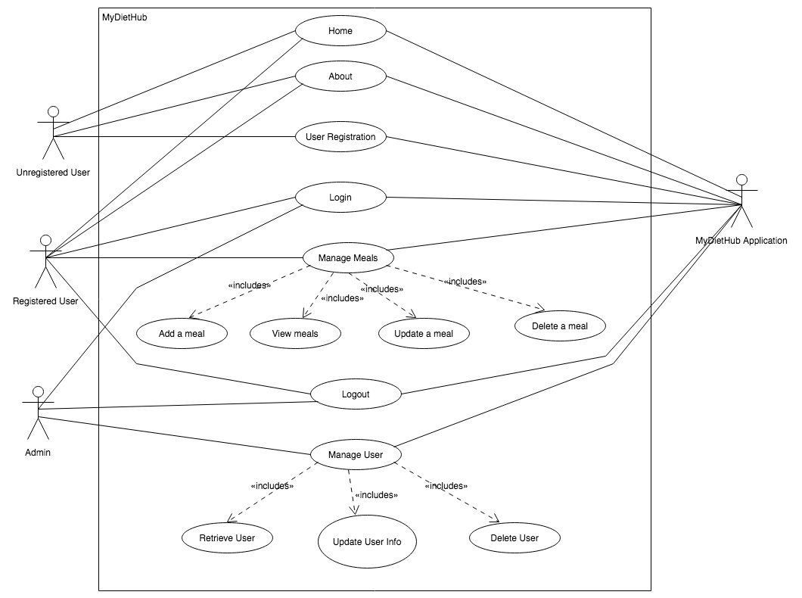
Use Case Diagram

Slide 31
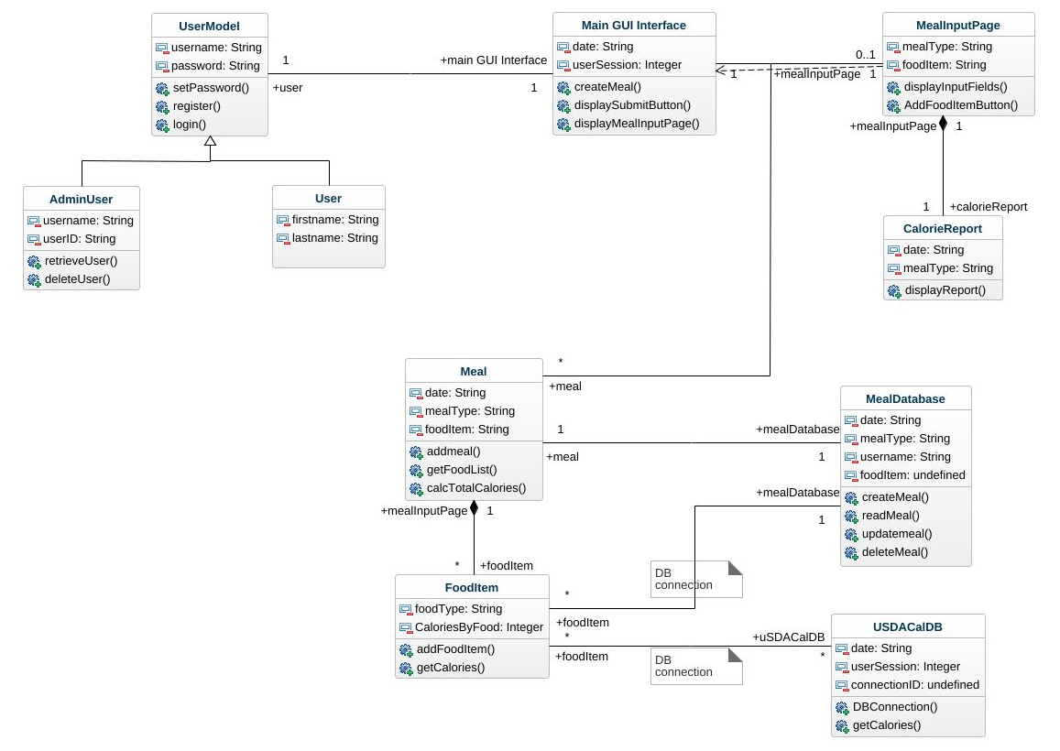
Class Diagram

Slide 32
Section V
Implementation
Presenter: Danny Graziano

Slide 33
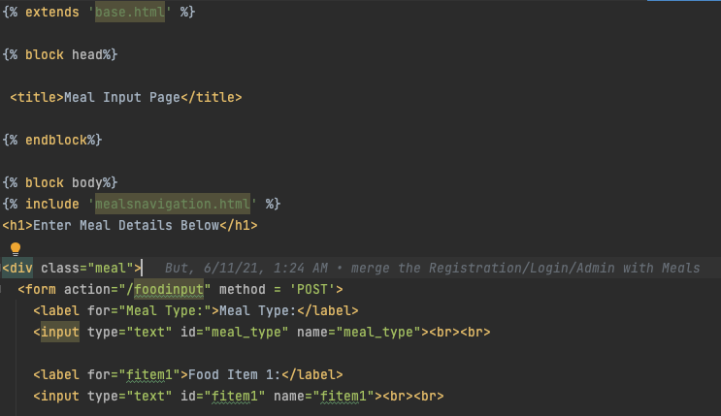

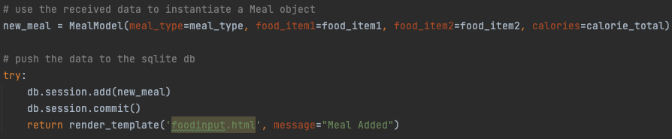
Implementation - Frontend
Flask used design forms, user management and site navigation
Simple framework to quickly get a prototype up and running
Html templates stored in templates folder, uses shared components for common elements across pages (navbar)
Models used in routes to fill in templates and generate pages for each context the user needs to access

Slide 34
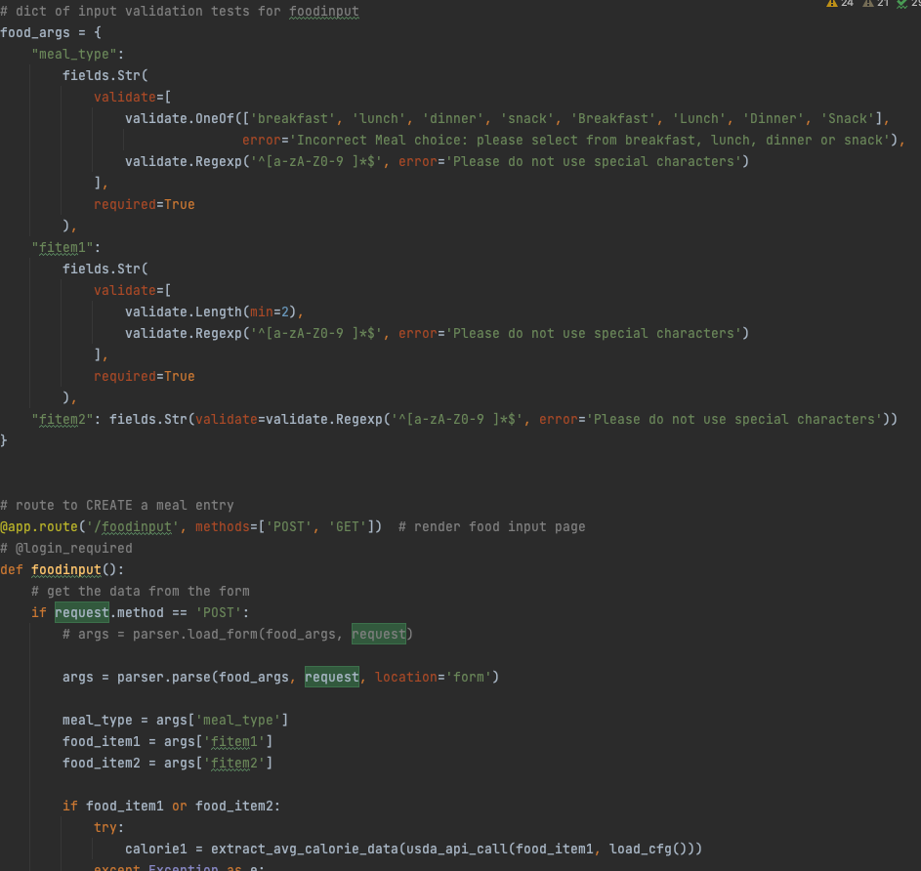
Implementation - Backend
Python backend with MCL architecture with 3 models, User, Admin & Meal
User & admin share a database with similar schema while the meal model has its own database (see previous table schema)
Models were divided based on essential non overlapping functions in models.py file.
Forms were validated in the backend via webargs and a custom validation error reporting page. This reduces the chance for user error or malicious usage by restricting the type of input users can enter into the forms. Can be expanded to cover more cases

Slide 35
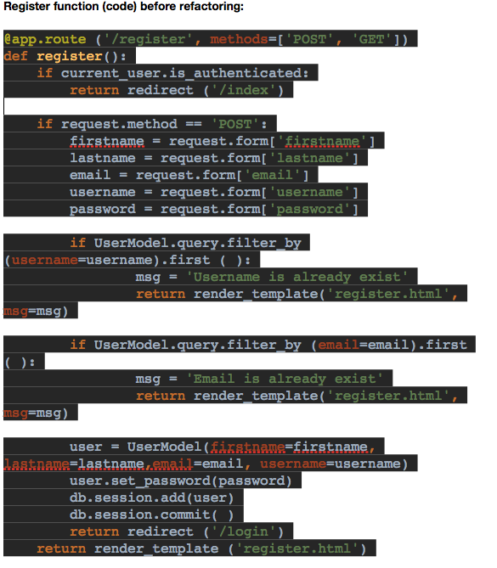
Refactoring - Example 1
During Iteration 2, the team completed initial refactoring for each of the three (3) key modules
The goal of the refactoring effort was to remove key code smells and employ a single responsibility principle by moving key functions to separate classes and files.
Examples of the refactoring effort:
Register Function Before Refactoring :

Slide 36
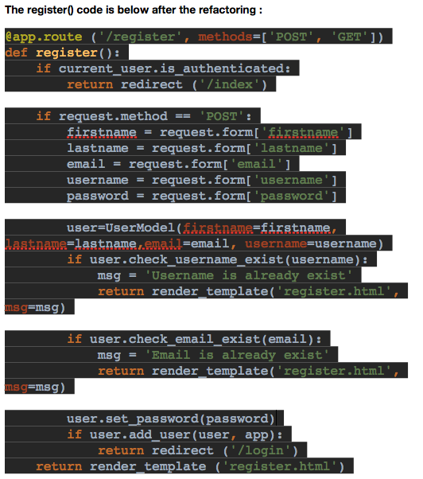
Refactoring - Example 1

Slide 37
Refactoring - Example 2
During Iteration 2, the team completed initial refactoring for each of the three (3) key modules
The goal of the refactoring effort was to remove key code smells and employ a single responsibility principle by moving key functions to separate classes and files.
Example 2 - Organization: Database code, control (route) code and Flask app instantiation code all in the same file, ‘app.py’. Screen shots below of app.py before & after refactoring show database code and routes

Slide 38
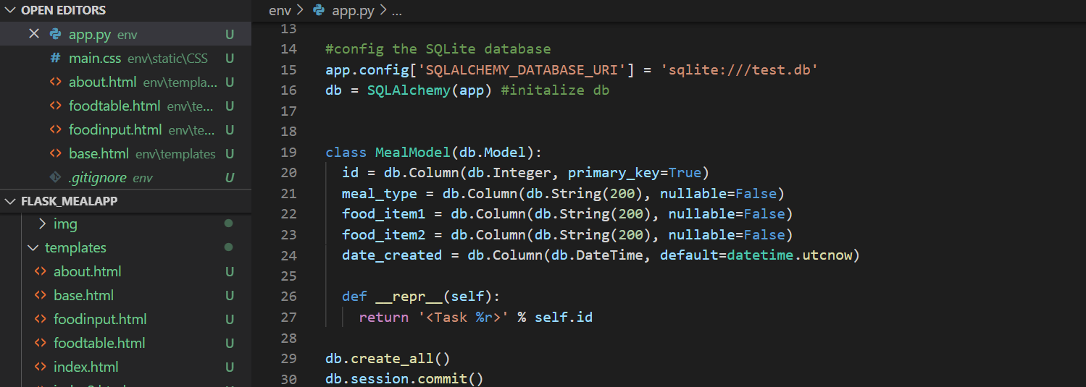
Refactoring - Example 2
Database code included in app.py before refactoring

Slide 39
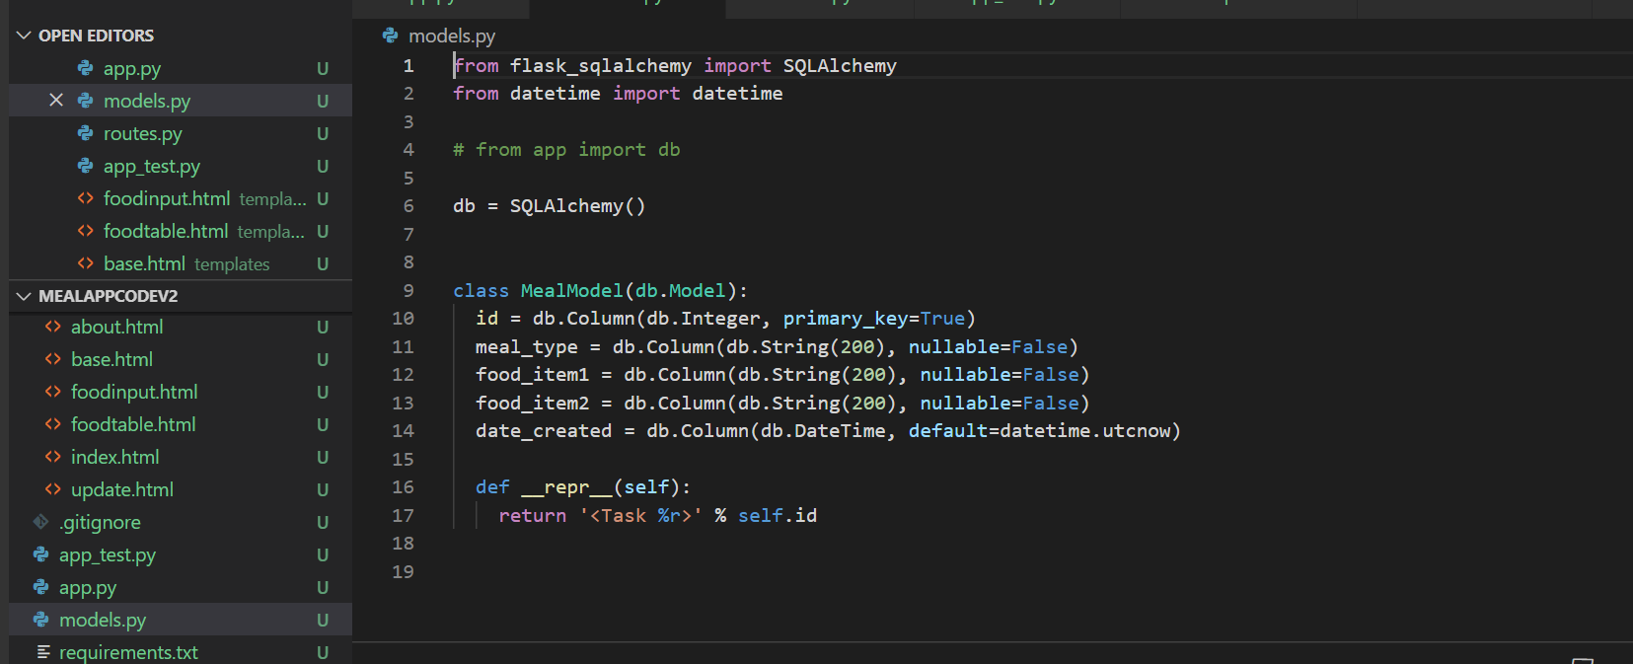
Refactoring - Example 2
Database code included in models.py after refactoring

Slide 40
Section VI
Testing
Presenter: Josephine But

Slide 41
Testing Plan & Results
Framework
Python unittest for unit testing
Use Selenium for automated system testing
Types of testing
UI Tests
Perform manually and use black box testing
Unit Tests
Perform automatically and use white box testing
Integration Tests
Perform manually and use white box testing
System Test
Perform automatically and use white box testing

Slide 42
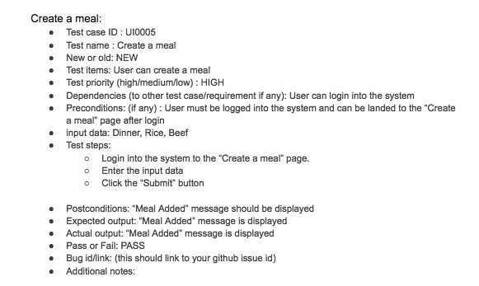
UI Testing
UI Tests: These tests are performed manually. Testers are to verify the visual elements of the application to validate whether they accurately meet the expected performance and functionality.

Slide 43
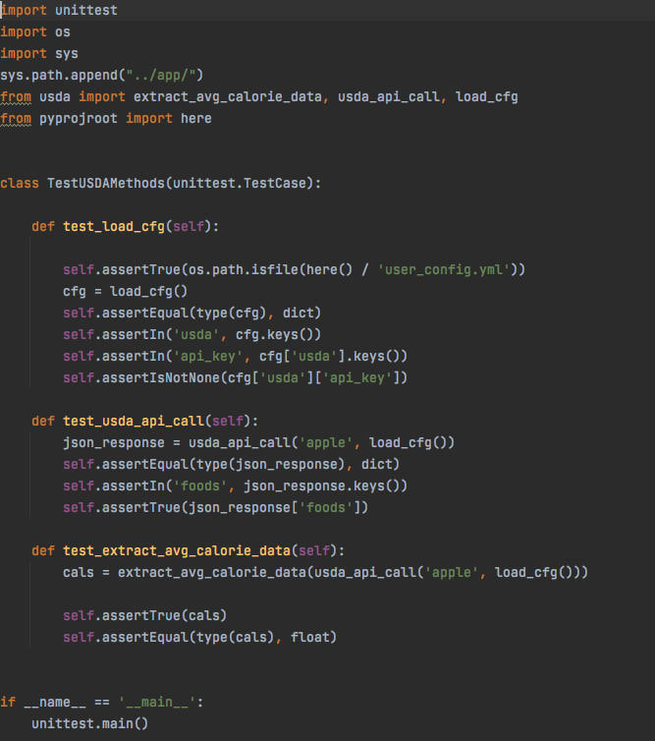
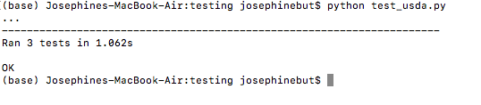
Unit Testing
Unit Tests : The purpose of the unit testing is to validate that each unit of the application performs as designed based on the User Stories. Developers use the Python unittest module to develop the tests and re-use the unit tests any time the unit is changed. We use white box testing for Unit Tests

Slide 44
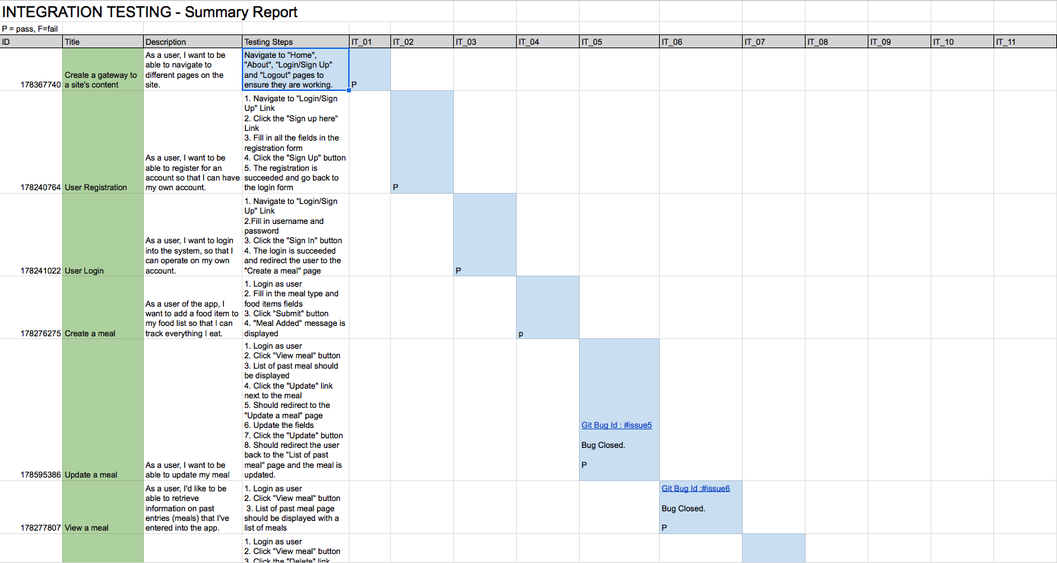
Integration Testing
Integration Testing : To test the modules/components when integrated to verify that they work as expected. The individual modules are first tested in isolation. Once the modules are tested, they are integrated one by one, till all the modules are integrated and validate whether the requirements are implemented correctly or not. We combined the Registration/Login/Admin, USDA API, & CRUD modules into one integrated system.

Slide 45
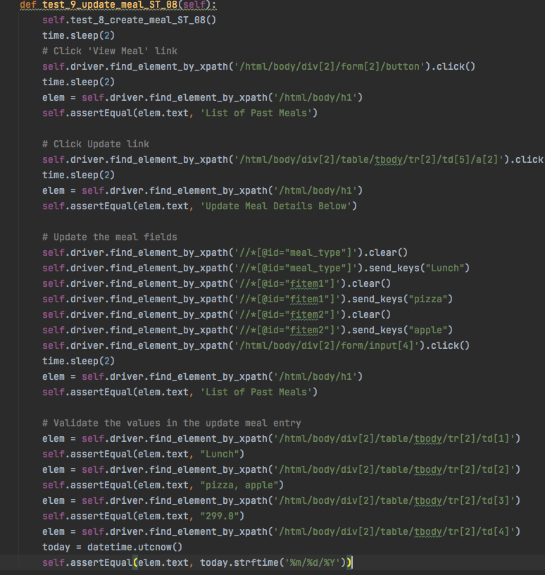
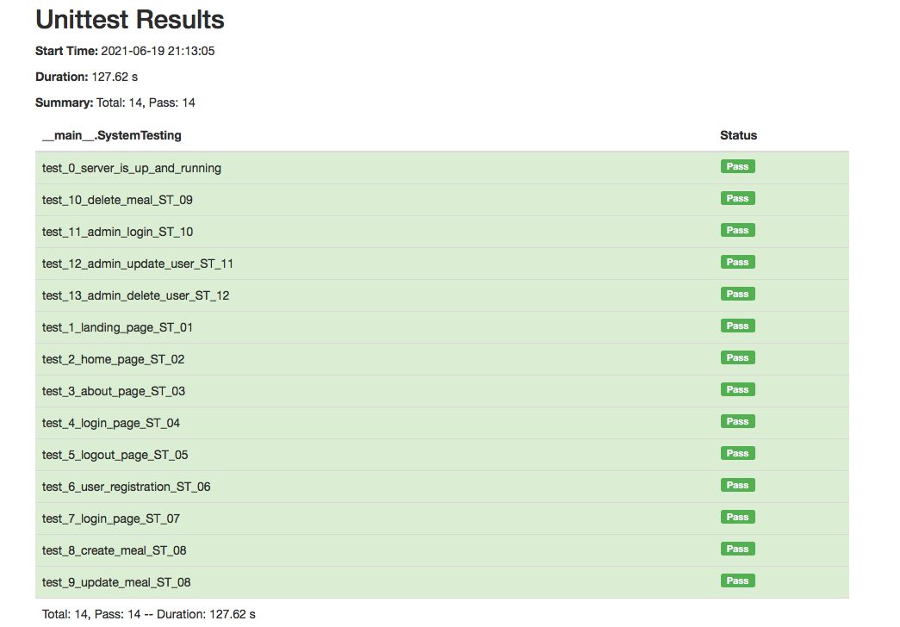
System Testing
System Tests: The purpose of the system testing is to test the system as a whole. All the components are integrated in order to verify if the system works as expected or not with the software and hardware. Developers use the Python Selenium module to develop the tests and execute the tests. The system testing is designed based on the requirements stored in Pivotal Tracker. The goal is to automate each test case so that it can serve as a tool to quickly test changes to our app and ensure our app is not broken due to the changes. It is executed in different OS( Mac & Windows) to ensure the app is working with different hardware.

Slide 46
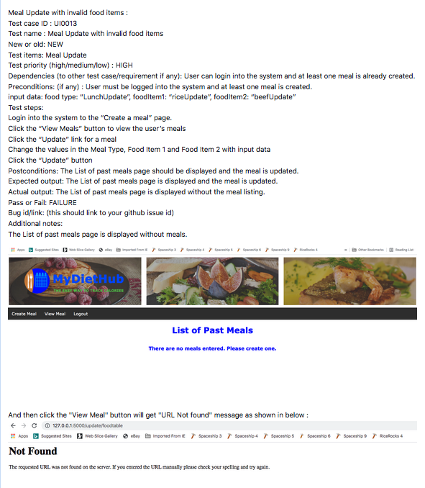
Defect Management
Defect Management : Testers that find bugs raise a ticket with the Git issues and assign the bug to a specific developer who developed that functionality. The tester will do the testing for that bug to ensure the bug is fixed. Reopen bug will assign it back to the developer, close the bug if it is fixed. Testing report also has a record of the bug.

Slide 47
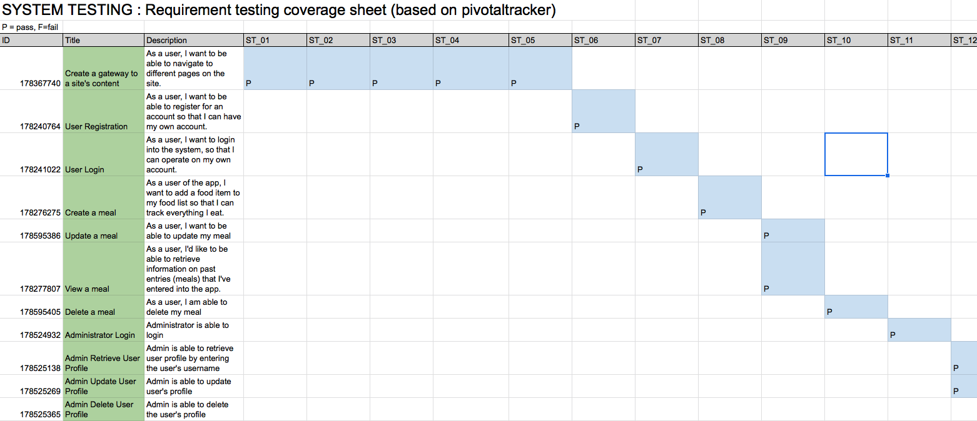

Slide 48


Slide 49
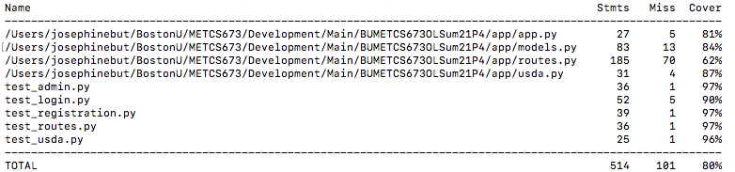
Code Coverage Report
The unit tests cover approximately 80% of the application.

Slide 50
Testing - Update Since Iteration 2
In Iteration 2, Meal update with invalid food items is not working
Bug fixed, retested and the bug is closed.
In Iteration 2, Wrong calories retrieve for a food item with separated word is not working
Bug fixed, retested and the bug is closed.
Implemented input validation in meal, login and registration modules in iteration 3
After implementation, ran the automated tests and all the tests are passed.

Slide 51
Testing Details
Number of Test cases
13 number of unit test cases in iteration 2. Implemented 14 test cases for system testing since iteration 2 . Total number of unit tests and automated tests are 27.
Functionality coverage
100%. Every single feature has been tested. 23% higher than iteration 2
Functionality of all the features are included in the iteration 3 for System Testing.
Code coverage
The unit tests cover approximately 80% of the application.
Defect Rate
Including all manual and automated tests, 11% defect rate

Slide 52
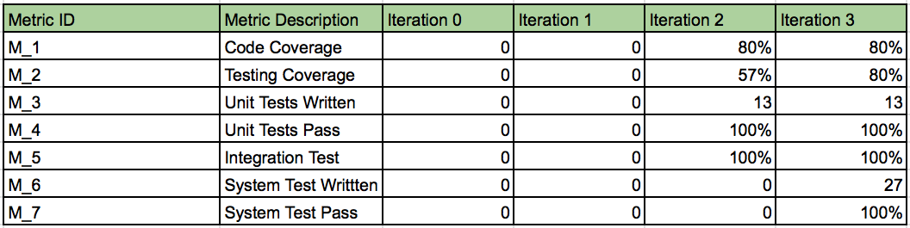
Testing Metrics

Slide 53
Section VII
Security
Presenter: Zixia Zhou

Slide 54
Security
Data Key
We take care to ensure that API keys we used to fetch the data from USDA are not exposed in our public code repository. They will be held in a separate configuration file that the user will populate with their own key.
User authentication
The user password before storing it into the database for security purposes. We use Flask-login, Werkzeug and we are going to use the method PBKDF2 to do the password hashing. PBKDF2 is a simple cryptographic key derivation function, which is resistant to dictionary attacks and rainbow table attacks. It is based on iteratively deriving HMAC many times with some padding.
User Management
In terms of controlling user access to different pages (add meals, update and delete meals) for meal security, only administrators can access user information and update and delete user records.

Slide 55

Security
Password
password: plaintext password
method: hash of the way (need to be hashlib library support), the format of PBPDF2(method='pbkdf2:sha256).

Slide 56
Section VIII
Deployment
Presenter: Ray Clark

Slide 57
Deployment - Heroku
Main Branch: https://mydiethub.herokuapp.com
Heroku uses buildpacks:
heroku/python/flask
On heroku, buildpacks run the processes for respective frameworks and install dependencies and modules into Heroku so that the app can run
Buildpacks are responsible for transforming deployed code into a slug, which can then be executed on a dyno
Buildpacks are composed of a set of scripts, and depending on the programming language, the scripts will retrieve dependencies, output generated assets or compiled code, and more. This output is assembled into a slug by the slug compiler

Slide 58
Section IX
Software Demo
Presenter: Team 4 Group

Slide 59
Code Demo and Release Branch Link
MyDietHub - software demo/code walk-through link:
https://drive.google.com/drive/folders/1jY57BpME7dkvXSOadgT6iVAWaUG92qd6?usp=sharing
(all documents including videos can be found here)
MyDietHub Release branch link - Github: Iteration 3 https://github.com/BUMETCS673/BUMETCS673OLSum21P4 (release v1.0 = Iteration 3)

Slide 60
Section X
Member Takeaways
Presenter: Team 4 Group

Slide 61
Team 4 - Member Takeaways...
Team Lead: Ray Clark
Experienced Complete SDLC
Improved Appreciation for Project Management - Agile/Scrum
Greatly Increased Knowledge & Use of Tools - Git/GitHub, Slack, Pivotal Tracker, Testing
Learned New Tech - Flask from Scratch!
Enjoyed First Time Collaboration on Code Development
Learned Heroku Deployment
OVERALL: Great Learning Experience!

Slide 62
Team 4 - Member Takeaways...
Requirements Leader: Chen Zhao
Learned a lot...

Slide 63
Team 4 - Member Takeaways...
Design & Implementation Leader: Danny Graziano
No experience with agile methodologies/product development cycle before this class, I’ve only written academic code and analysis pipelines
Forced me out of my functional programming shell into Object Oriented approaches
Gained experience with working on a team with different specialization tasks and skill sets
First project I’ve worked on that’s implemented MCL!
Wish we had more time to implement more of our optional features (calorie tracking graphs would have been neat!)

Slide 64
Team 4 - Member Takeaways...
QA Leader: But Wing Han Josephine
Good practice and experience in SDLC
Learned New programming languages and different packages - Flask, Flask-login, werkzeug.security, sqlalchemy and Selenium
Gain knowledge of using different Tools - Git/GitHub, Slack, Pivotal Tracker and Testing tools.
Improved knowledge of Requirement Analysis, System and Software Design, Security and Testing Techniques
Improved presentation skills
Great learning Experience!

Slide 65
Team 4 - Member Takeaways...
Configuration Leader: Huimin Diao
Learned how to use different tools - Git/GitHub, Slack, Pivotal Tracker
Gain knowledge of Front-end development - HTML, CSS, Javascript
Learned how to use balsamiq - build ware frames
Learned new programing languages - Flask
First time team collaboration project
In summary: Great Learning Experience!

Slide 66
Team 4 - Member Takeaways...
Security Leader: Zixia Zhou
Learned how to use Git/GitHub, Slack, Pivotal Tracker
I had no experience with the product development cycle before this course and experiencing team project work.
Learned to encrypt user passwords using hash
Learned new programing - Flask
Great learning Experience!

Slide 67


